Slide 1

RPC & NFS
Computer System Engineering, Fall 2019. (IPADS, SJTU)
Enable Client/Server model
Yubin Xia

Slide 2


Current Status
We can build a Taobao from scratch on one machine!
Web Server
Accept requests & reply files in HTTP
7 layers, inode, FAT, VFS, FS API, Crash consistency
File System
Socket
Disk Driver
NIC Driver
Interrupt handling
System Bus
PIO, MMIO, DMA
Disk
NIC
Disk structure, SSD, Optimization

Slide 3



Challenges
One machine is NOT enough
  More and more pictures to save
  More and more clients to serve
Multiple servers are needed
  One server with large storage, to save more files
  Multiple servers run web server, to server more clients
How to build a Network File System (NFS)?
  Seems like every server can share the large storage

Slide 4
RPC
Remote Procedure Call

Slide 5
RPC
RPC （Remote Procedure Call)
  Allow a procedure to execute in another address space without coding the details for the remote interaction
RPC History
  Idea goes back in 1976
  Sun's RPC: first popular implementation on Unix
    Used as the basis for NFS
RMI (Remote Method Invocation)
  Object-oriented version of RPC, e.g. in Java

Slide 6
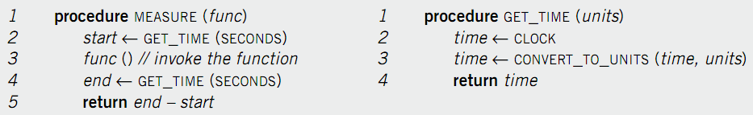
Example of RPC
Re-implement MEASURE and GET_TIME
  Run GET_TIME on a server
  Call GET_TIME on a client
Notes:
Occam's Razor.

Slide 7
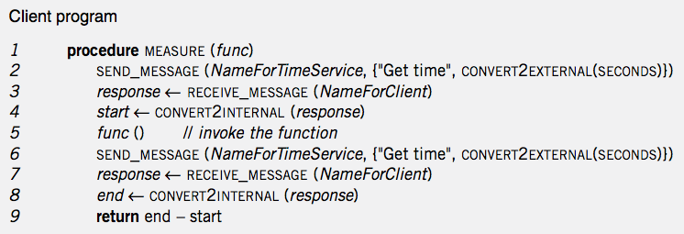
Client Program
Notes:
Marshal: line 2 6
unmarshal: line 4 8

Slide 8
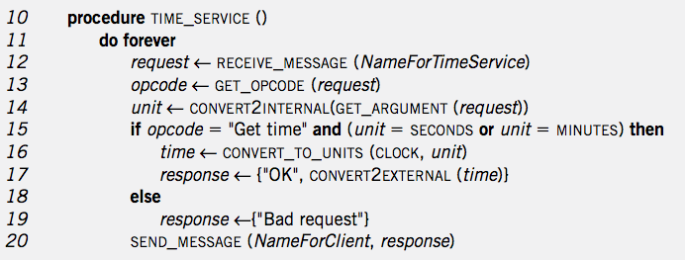
Service Program
Notes:
Marshal: 16-19
Unmarshal: 13 14

Slide 9
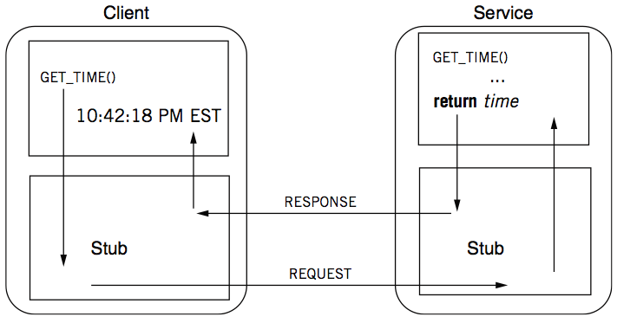
RPC Calling Process

Slide 10
RPC Stub
Client stub
  Put the arguments into a request
  Send the request to server
  Wait for a response
Service stub
  Wait for a message
  Get the parameters from the request
  Call the procedure (e.g. GET_TIME)
  Put the result into a response
  Send the response to the client
Stub: hide communication details from up-level code, so that up-level code does not change

Slide 11
Client Program using RPC
procedure MEASURE (func)
start <- GET_TIME(SECONDS)
func()
end <- GET_TIME(SECONDS)
return end - start
Note: this code is not changed
This is stub of client
procedure GET_TIME (units)
SEND_MESSAGE(ServerName, {"Get time", CONVERT2EXTERNAL(units)})
response <- RECEIVE_MESSAGE(ClientName)
if GET_RETCODE(response) != "OK"
HANDLE_ERROR(response)
else
return CONVERT2INTERNAL(GET_ARGUMENT(response))
Notes:
Marshal: line 2 6
unmarshal: line 4 8

Slide 12
Server Program using RPC
procedure GET_TIME (units)
time <- CLOCK
time <- CONVERT_TO_UNITS(time, units)
return time
Note: this code is not changed
This is stub of server
procedure TIME_SERVICE ()
do forever
request <- RECEIVE_MESSAGE(ServerName)
opcode <- GET_OPCODE(request)
arg <- CONVERT2INTERNAL(GET_ARGUMENT(request))
if opcode = "Get time" and (arg = SECONDS or arg = MINUTES) then
retval <- GET_TIME(arg)
response <- {"OK", CONVERT2EXTERNAL(retval)}
else
response <- {"Bad request"}
SEND_MESSAGE(ClientName, response)
Notes:
Marshal: line 2 6
unmarshal: line 4 8

Slide 13
Question
What is inside a message?
  Service ID (e.g., function ID)
  Service parameter (e.g., function parameter)
  Using marshal / unmarshal

Slide 14
RPC Request
  UDP header...
    Xid
    call/reply
    rpc version
    program #
    program version
    procedure #
    auth stuff
    arguments
X is short for "transaction"
Client reply dispatch uses xid
Client remembers the xid of each call
Server dispatch uses prog#, proc#

Slide 15
RPC Reply
  UDP header …
    Xid
    call/reply
    accepted? (vs bad rpc version, or auth failure)
    auth stuff
    success? (vs bad prog/proc #)
    results

Slide 16
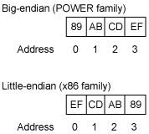
Marshal / Unmarshal
Marshal
  Convert an object into an array of bytes with enough annotation so that the unmarshall procedure can convert it back into an object
Serialization is not easy
  E.g., big endian VS. little endian
    Big endian on network
    Two functions: htons(), ntohs()
  Using IEEE 754 or not?
  What about an array?
  What about a pointer?

Slide 17
Automatic Stub Generation
Generate stubs from an interface specification
  Tool to look at argument and return types
  Generate marshal and unmarshal code
  Generate stub procedures
  Saves programming (thus less error)
  Ensures agreement on argument types
    E.g., consistent function ID

Slide 18
RPC System Components
1. Standards for wire format of RPC message and data types
2. Library of routines to marshal / unmarshal data
3. Stub generator, or RPC compiler, to produce "stubs"
  For client: marshal arguments, call, wait, unmarshal reply
  For server: unmarshal arguments, call real function, marshal reply

Slide 19
RPC System Components
4. Server framework:
  Dispatch each call message to correct server stub
5. Client framework:
  Give each reply to correct waiting thread / callback
6. Binding: how does client find the right server?

Slide 20
Client Framework
Keeps track of outstanding requests
  For each, xid and caller's thread / callback
Matches replies to caller
Might be multiple callers using one socket
Usually handles timing out and retransmitting

Slide 21
Server Framework
Type-1: Create a new thread per request
  Master thread reads socket[s]
Type-2: Use a fixed pool of threads
  Use a queue if too many requests
  E.g., NFS server
Type-3: Just one thread for serial execution
  Simplifies concurrency, e.g., the X server

Slide 22
Concurrent RPC
Key feature: support for concurrent RPCs
  If one RPC takes multiple blocking steps, can the server serve another one in the meantime?
    For example, DNS service routine itself is an RPC client
  May also avoid deadlock if one sends RPC to itself
Notes:
fdcb() calls un-marshaling function

Slide 23
Client & Server (C/S Model)
Enforced modularity

Slide 24
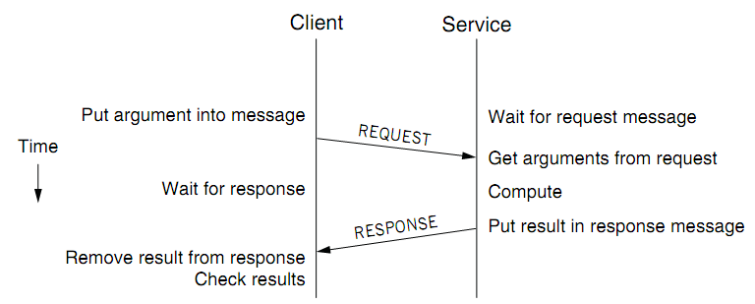
Client/Service Organization
Limit interactions to explicit messages
  Client: request; service: response or reply
  On different computers, connected by a wire
    Chap 5 will explain how to get them into one computer

Slide 25
C/S Model
Client/Service model
  Separates functions (abstraction)
  Enforces that separation (enforced modularity)
  Reduce fate sharing but not eliminate it
Notes:
Occam's Razor.

Slide 26
Multiple Clients and Services
One services can work for multiple clients
  E.g., one file server for multiple clients
One client can use several services
  E.g., one client can connect to multiple file servers
One module can be both a client and a service
  E.g., printer as a service for printing request, while also as a client of the file service

Slide 27
Trusted Intermediaries
Service as trusted 3rd party
  Run critical procedures as a service
  E.g., a file service to keep clients' file distinct, email service
  Enforces modularity among multiple clients
  Ensures that a fault in one client has limited effect on another client
Thin client computing (the ultimate version of C/S?)
  Simplify clients by having the trusted intermediary provide most functions
  Only the trusted intermediaries run on powerful computers
  What if the powerful computers fail…

Slide 28
RPC != PC
RPCs can reduce fate sharing
  Set a time-out for message lost or service failure
RPCs introduce new failures: no response
RPCs take more time
  Stub itself may cost more than a service
  Consider using RPC in device driver: time-out error
  Not suitable for all cases

Slide 29
RPC: Failure Handling
Most network systems and applications also have these considerations
1. At least once
  Client keeps resending until server responds
  Only OK if without side effects on server
2. At most once
  Client keeps resending (may time-out)
  Server remembers requests and suppress duplicates?
  Idempotent functions
3. Exactly once
  This is often what we really want
  Hard to do in a useful way, later in Chap-8 and 10
Most RPC systems do #1 or #2

Slide 30
Other Differences
Language support
  Some features do not combine well with RPC
    E.g., inter-procedure communicate through global variable
  Data structure that contains pointers
Security consideration
  Both client and server need authentication
  Side channel attacks through network pattern

Slide 31
Questions
Q: Why RPC and C/S?
  Programmers make mistakes
  Mistakes propagate easily
  Enforce modularity
Q: What does RPC do, exactly? Can we use other ways?
  E.g., socket? HTTP? Why not use them?
  Be more friendly for programmers

Slide 32
CASE STUDY: CORBA

Slide 33
IDL for Interface Definition
Can the service uses Java while client uses C?
  Yes, they just need to use the same RPC protocol
IDL: describe a function for all languages
  Interface Definition Language
  Specify names, parameters, return values, etc.
  Pre-compiler use IDL to generate stubs for client/server
  Similar to function prototypes

Slide 34
IDL Example: CORBA IDL
module BankSimple {
struct CustomerDetails {
string name;
short age;
};
interface Bank {
CustomerDetails getCustomerDetails (in string name);
};
};

Slide 35
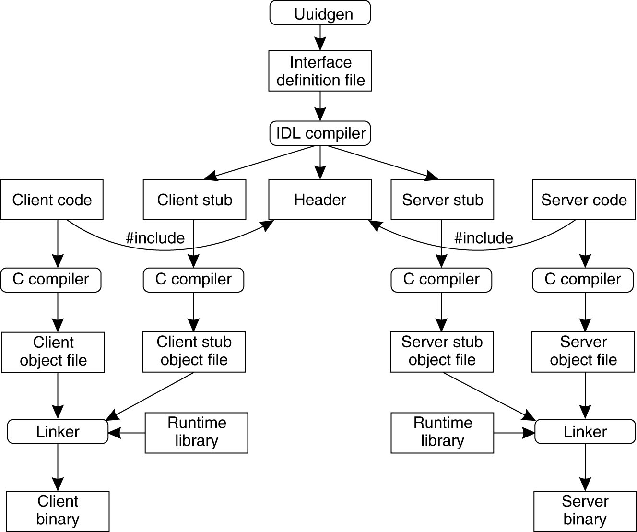
Putting Together
Programmer
Generated

Slide 36
Binding a Client to a Server
Registration of a server makes it possible for a client to locate the server and bind to it
Server location is done in two steps:
  Locate the server's machine
  Locate the server on that machine
    'Server' here means service in software

Slide 37
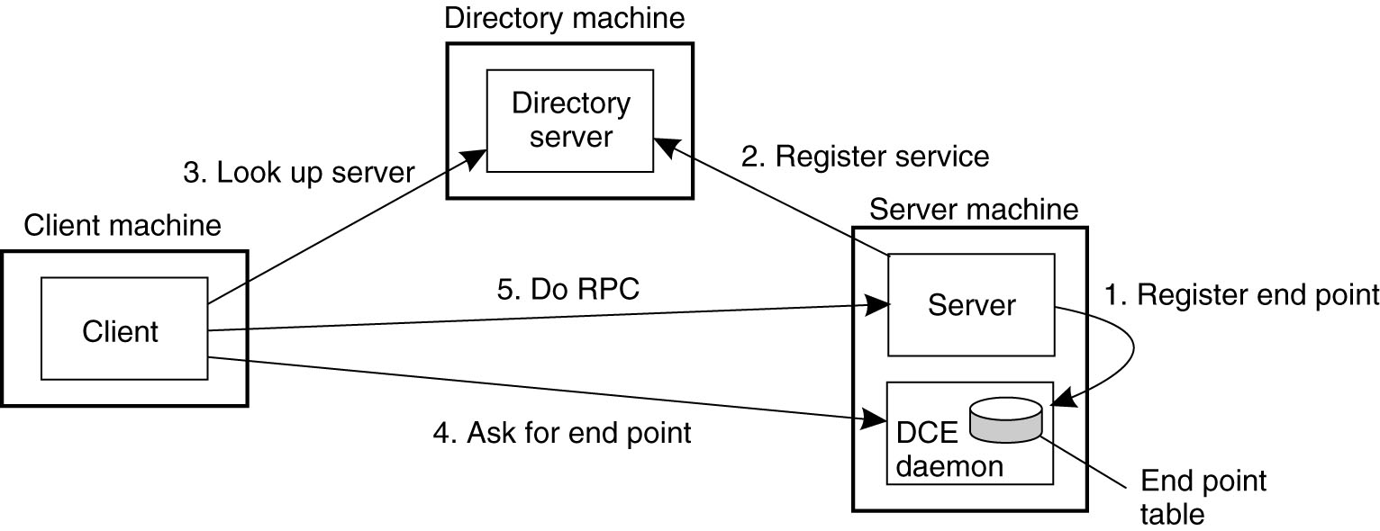
Binding a Client to a Server: Example
DCE example: (Distributed Computing Environment)

Slide 38
Case Study: NFS

Slide 39
NFS (Network File System)
History
  Sun, 1980s, designed for workstations
  Centralized management: easy to share & backup files
  Cost benefit: workstations without disks
NFS goals
  Transparency: compatibility with existing applications
  OS independent: clients even in DOS
  Easy to deploy
  # mount –t nfs 10.131.250.6:/nfs/dir /mnt/nfs/dir

Slide 40
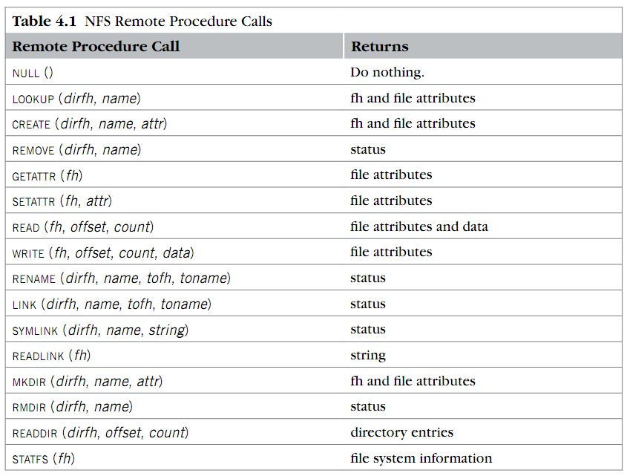
RPC in NFS
Where is OPEN and CLOSE?

Slide 41
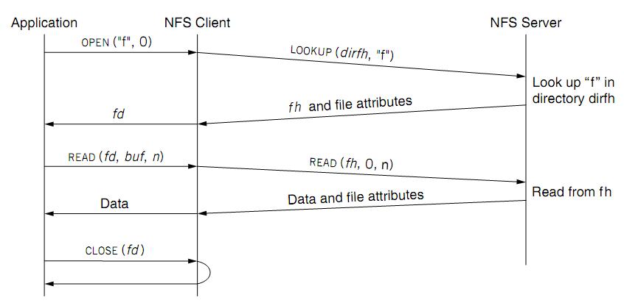
NFS Overview
fd <--> fh (file handler)
No state after open()

Slide 42
File Handler for a Client
File handler contains three parts
  File system identifier: for server to identify the file system
  inode number: for server to locate the file
  Generation number: for server to maintain consistency of a file
Can still work across server failures
  E.g., server reboot
Q: Why not put path name in the handle?

Slide 43
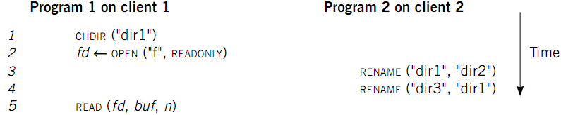
Case 1: Rename After Open
UNIX Spec:
  Program 1 should read "dir2/f"
  NFS should keep the spec

Slide 44
Stateless on NFS server
Stateless on NFS server
  Each RPC contains all the information
Q: What about states like file cursor?
  Client maintains the states, including the file cursor
Client can repeat a request until it receives a reply (at least once)
  Server may execute the same request twice
  Solution: each RPC is tagged with a transaction number, and server maintains some "soft" state: reply cache
  Q: What if the server fails between two same requests?
Notes:
What about the case of "delete-after-open"?

Slide 45
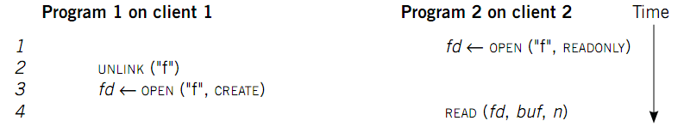
Case 2: Delete After Open
UNIX spec:
  On local FS, program 2 will read the old file
How to avoid program 2 reading new file?
  Generation number
  "stale file handler"
Not the same as UNIX spec! It's a tradeoff...

Slide 46
Cache on the Client
NFS client maintains various caches
  Stores a vnode for every open file
    Know the file handles
  Recently used vnodes, attributes, recently used blocks, mapping from path name to vnode
Cache benefits
  Reduce latency
  Less RPC, reduce load on server
Cache coherence is needed

Slide 47
Coherence
Read/write coherence
  On local file system, READ gets newest data
  On NFS, client has cache
  NFS could guarantee read/write coherence for every operation, or just for certain operation
Close-to-open consistency
  Higher data rate
  GETATTR when OPEN, to get last modification time
  Compare the time with its cache
  When CLOSE, send cached writes to the server
Notes:
Mixed blocks, old and new

Slide 48
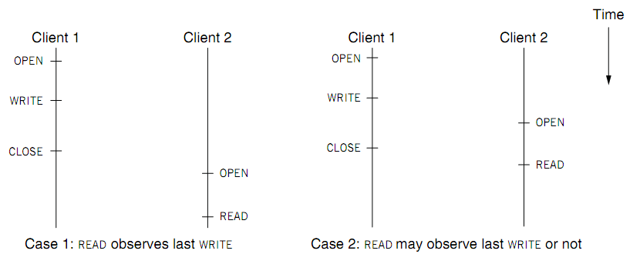
Coherence
Two cases of close-to-open consistency
More contents of consistency in chapter 9 and 10

Slide 49
Extend the UNIX FS to support NFS
Vnode
  Abstract whether a file or directory is local or remote
  In volatile memory (why?)
  Support several different local file system
  Where should vnode layer be inserted?
Vnode API
  Same as we learnt: OPEN, READ, WRITE, CLOSE…
  Code of fd_table, current dir, file name lookup, can be moved up to the file system call layer

Slide 50
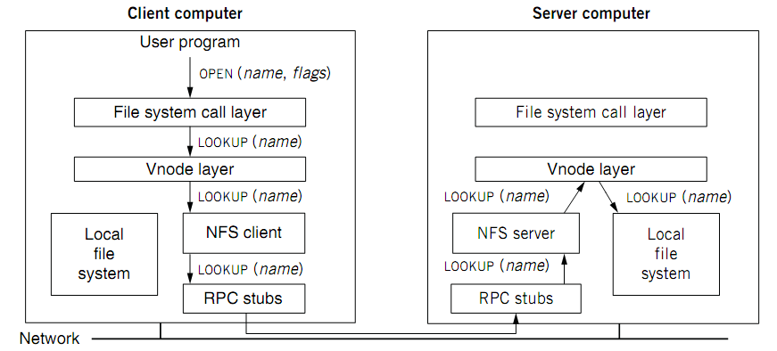
Extend the UNIX FS to support NFS

Slide 51
Reference Materials
Textbook
  Chapter 4.2 & 4.5
RFC 1831: RPC Specification
  http://www.ietf.org/rfc/rfc1831.txt?number=1831
RFC 1832: XDR Specification
  http://www.ietf.org/rfc/rfc1832.txt?number=1832

